Slide 1

Assessment Self-Presentation
Lead Software Test Automation Engineer Level 4
Semenikhin Mykhailo
January 2024

Slide 2
Current title: Senior Software Test Automation Engineer, Automated Testing in JS
Current roles: AQA Lead on the Merck playwright automation team (3 persons).
My main responsibility is building and develop complex AQA processes on the projects.
Cross project communication with PO from different projects
Key Skills: strong planning and reporting skills, nice communication and fast learning skills. Has huge experience in mentoring and interviewing processes
Certificates/Educational Programs: DEVClub (Software Developing ), SCRUM certificate, SAFE certificate, Team Leads Grow UA #31, Automated Testing Global Mentoring Program: Expert, ISTQB and more then 20 others.
Introduction – Who I am

Slide 3
Working Experience/Career Path
Here provided only AQA specific experience
8 years of combination manual/codeless/JAVA/JS automation
3 years of combination JS/TS UI automation.
Has built and manage successfully automation teams from the start (3 times).
2012
INTROPRO (Manual/JAVA testing)
QA Engineer
2019
EPAM – ThinMonitor (2 projects) (Selenium tests automation in TS/BDD)
AQA Lead
2022
EPAM – Amwell (2 projects) (Cypress tests automation in TS/API)
Senior AQA/Acting QA Lead
2014
SDL Ukraine (Manual/JS testing)
QA Engineer
2022
EPAM – ASOS (WebdriverIO tests automation in TS/BDD)
AQA/QA Lead
2023
EPAM – Merck (Playwright tests automation in TS)
AQA Lead

Slide 4

Contribution to projects and my achievements
During working with EPAM.
4 times build automation process and infrastructure from the start to successful working process.
Mentee 5 AQA Engineers.
Implement BDD into dev pipeline in 80% projects
Build total CI\CD approach with 100% automation coverage and appropriate test pyramid
Merck: Change automation from python to TS playwright, mentee previous AQA, create test plan, metrics and infostructure for CI, expanded current approach to another projects. Supplanted another vendor on the projects. Increase team quantity to 3 people. Added UI in Jenkins for tests running into all envs. Added not functional tests.

Slide 5
Contribution to EPAM and non-project activities
Additional to continues growing and learning my self as part EPAM`s asset
Main current items :
Mentee 5 AQA Engineers (3 up one level during the year)
Took part in Automation Conferences (in Ukraine and Europe)
Share BDD approach in other projects
Promote EPAM code coverage approach (Drill4j)
Took part in Test Hackathons (in Ukraine and Europe)
Interviewed more then 30 people to my and different other projects

Slide 6
Additional Information
IT and non-IT
I have two non-IT high graduate degree with 6 years experience on them. The last achievement:
Marketing - Lead of learning department (on electronics market)
Lawyer – Senior lawyer Kiev office of “Green party of Ukraine”.
Time to time take part as teacher at the outside QA courses
Volunteer on AI Implementation

Slide 7

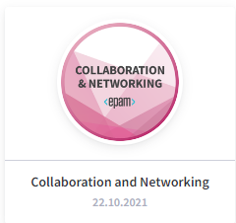
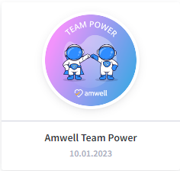
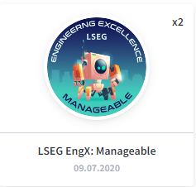
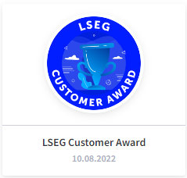
EPAM Badges
Relative to the projects

Slide 8
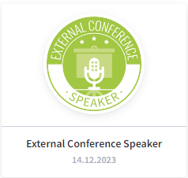

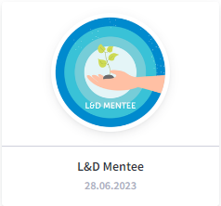
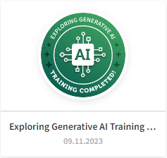

EPAM Badges
Relative to the non-projects

Slide 9
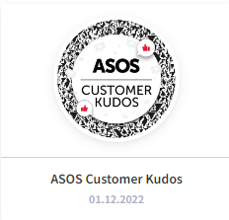
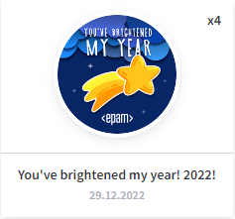
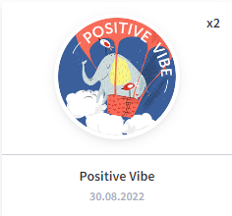
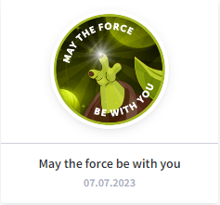
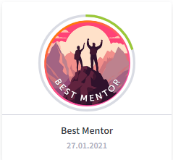
EPAM Badges
Relative to the team

Slide 10
Summary
I have successful experience as AQA and QA lead on 5 different projects (up to 3 members in the team)
Total experience of building and management IT teams are more then 3 years
I want to continue growing and focused on the AQA Lead role
I planned to manage team more then 3 members
Resolve dissonance between my role on the project (on Merck side I’m AQA Lead badge) and title on EPAM side

Slide 11
Thank you!

